Slide 1
Business Process Engineering
Week 03

Slide 2
Business-to-Business Processes
The business motivation behind interacting business processes stems from value systems, which represent collaborations between the value chains of multiple companies.
These high-level collaborations are realized by interacting business processes, each of which is run by one company in a business to business process scenario.

Slide 3
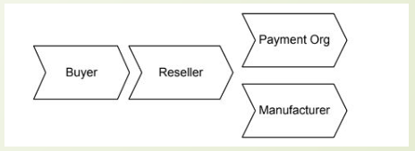
Business-to-Business Processes
A buyer orders goods from a reseller, who acts as an intermediary.
The reseller sends a respective product request to a manufacturer, who delivers to product to the buyer. In addition, the reseller asks a payment organization to take care of the billing.

Slide 4
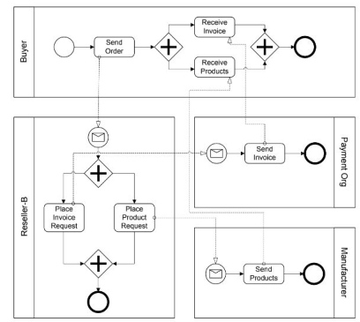
Example of business-to-business collaboration through interacting business processes

Slide 5
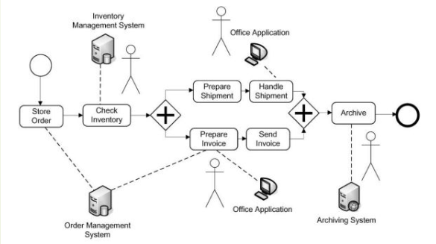
Business-to-Business Processes
Workflows in which humans are actively involved and interact with information systems are called human interaction workflows.

Slide 6
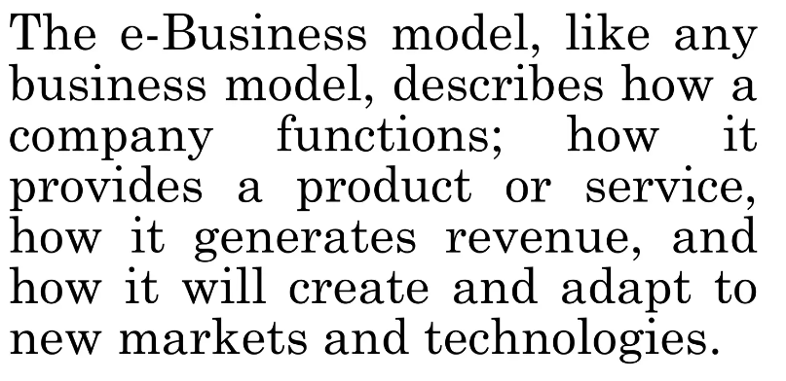
Value Chain Model

Slide 7
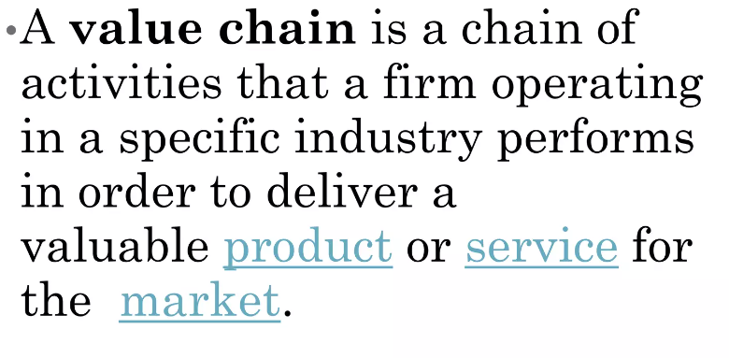
Meaning

Slide 8
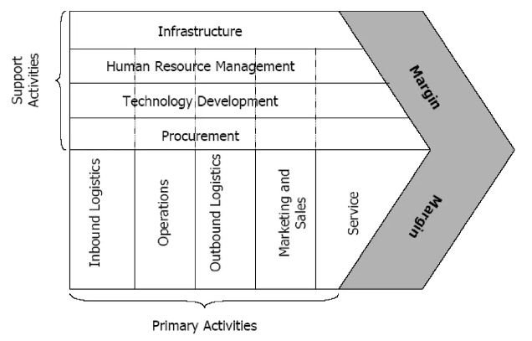
Model

Slide 9
Primary Activities
Primary activities consist of five components, and all are essential for adding value and creating competitive advantage:
Inbound logistics include functions like receiving, warehousing, and managing inventory.
Operations include procedures for converting raw materials into a finished product.
Outbound logistics include activities to distribute a final product to a consumer.
Marketing and sales include strategies to enhance visibility and target appropriate customers—such as advertising, promotion, and pricing.
Service includes programs to maintain products and enhance the consumer experience—like customer service, maintenance, repair, refund, and exchange.

Slide 10
Support Activities
The role of support activities is to help make the primary activities more efficient. When you increase the efficiency of any of the four support activities, it benefits at least one of the five primary activities. These support activities are generally denoted as overhead costs on a company’s income.
Procurement concerns how a company obtains raw materials.
Technological development is used at a firm's research and development (R&D) stage—like designing and developing manufacturing techniques and automating processes.
Human resources (HR) management involves hiring and retaining employees who will fulfill the firm's business strategy and help design, market, and sell the product.
Infrastructure includes company systems and the composition of its management team—such as planning, accounting, finance, and quality control.

